Slide 1
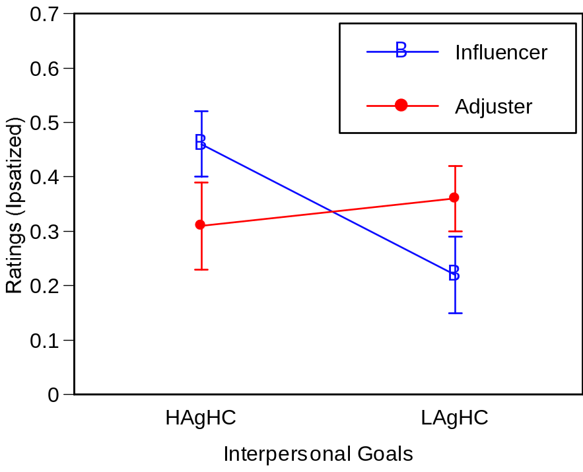
***
**
Partner X Goal Type: F(1,47) = 26.55, p <.001

Slide 2
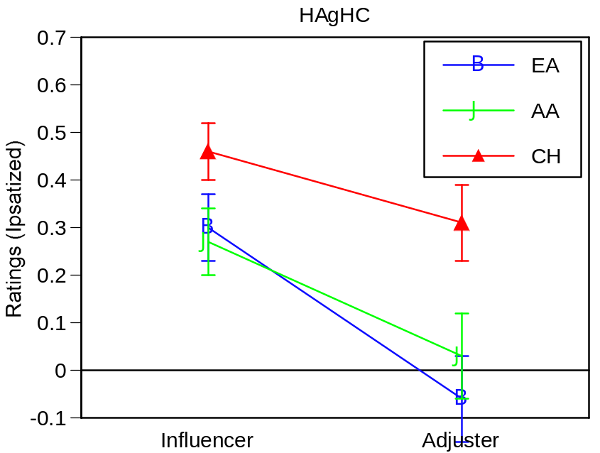
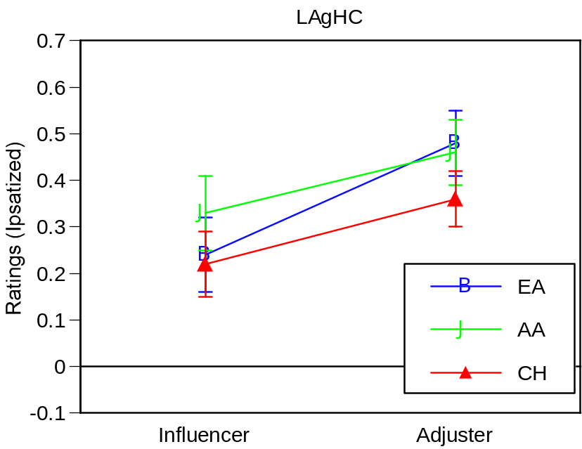
Partner: F(1,47) = 16.01, p < .001
Partner: F(1,47) = 9.05, p < .01

Slide 3
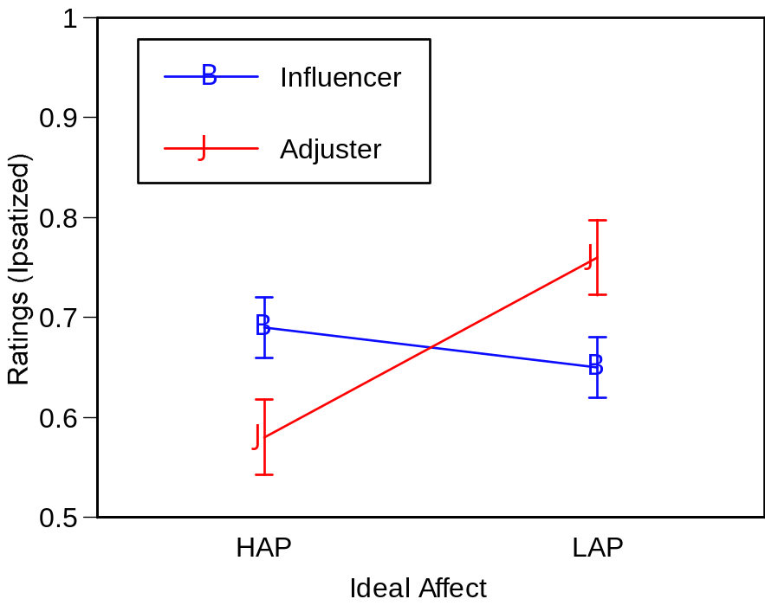
*
*
Partner X Affect Type: F(1,47) = 6.47, p <.05

Slide 4
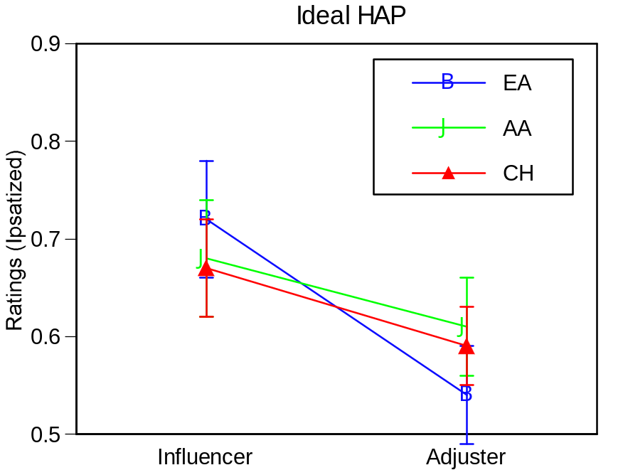
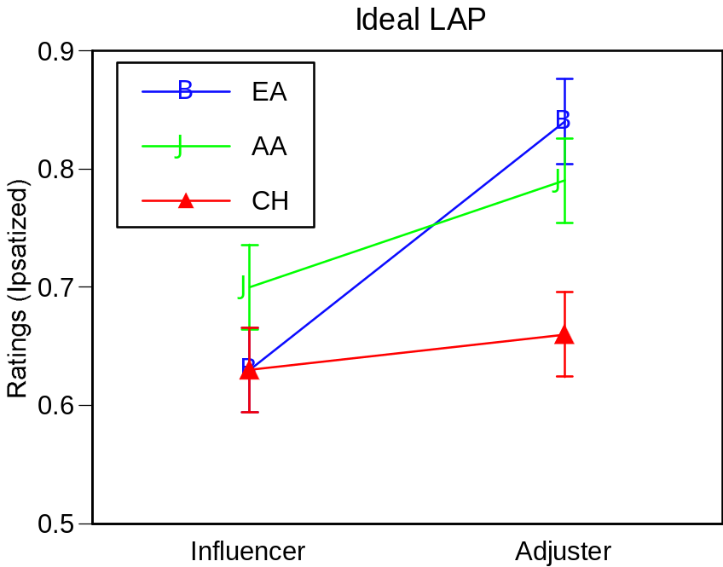
Partner: F(1,47) = 6.11, p <.05
Partner: F(1,47) = 5.81, p <.05

